Slide 1
Specimen Identification
Name
Institution of Affiliation

Slide 2
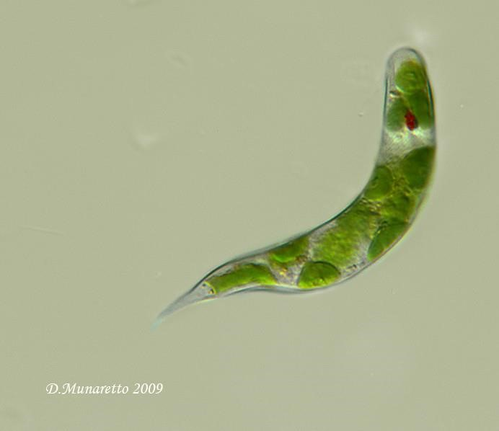
6.3 Supergroup Excavata
Euglena; Mag: N/A
The specimen is identified from its protruding flagella at one end.
flagellum

Slide 3
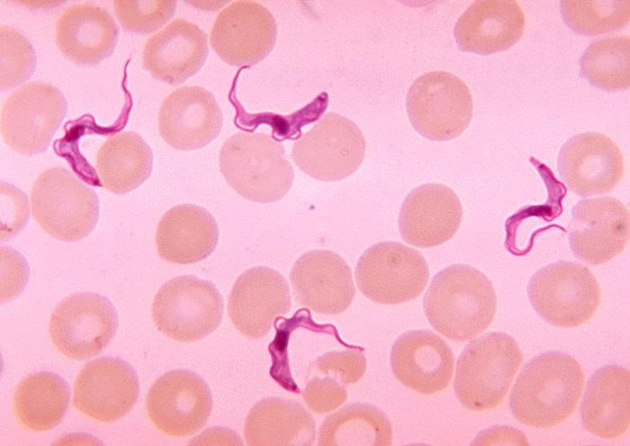
6.3 Supergroup Excavata
Trypanosoma
Mag: N / A
This organism is distinctive from its slot-like feeding groove that runs along the side of the cell as well as its flagellum.
flagellum

Slide 4
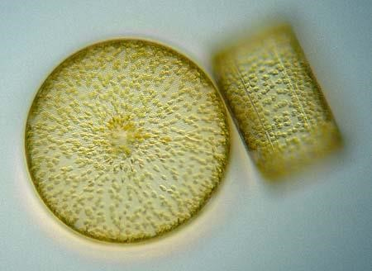
6.4 SAR Clade- Stramenoplles- Diatoms
Centrate morphology
Mag: N/A
Centrates are spherical

Slide 5
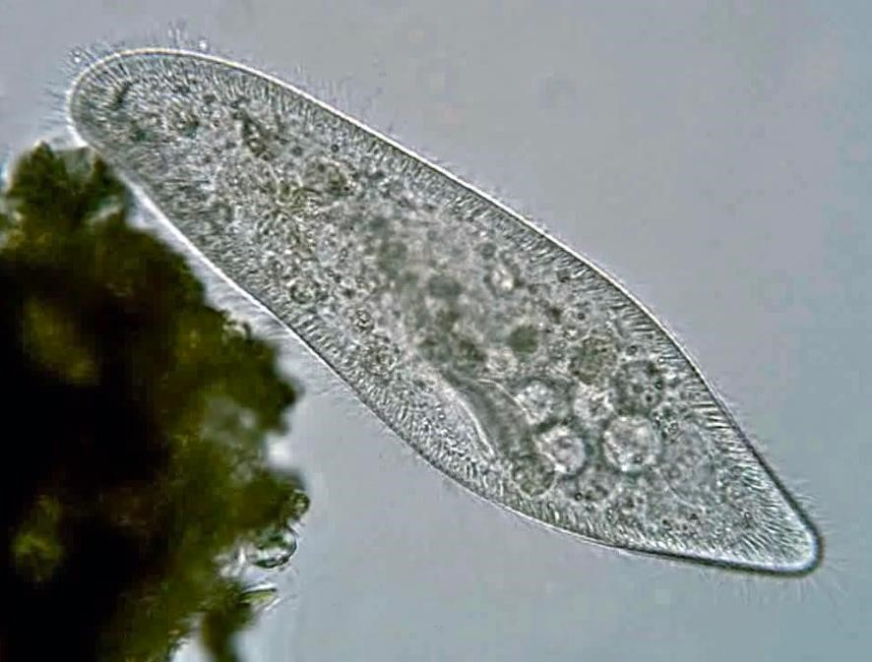
6.4 SAR Clade- Stramenoplles- Diatoms
Pinnate morphology
Mag: N/A
Pennate diatoms show a long slit, the raphe, along the long axis.

Slide 6
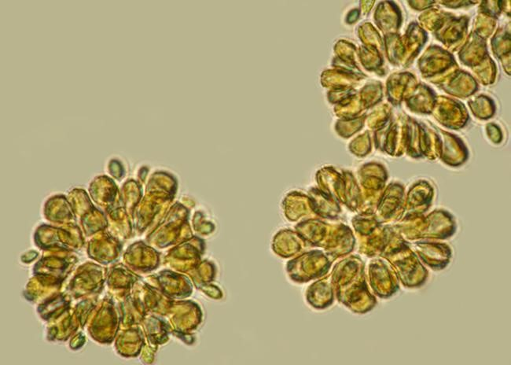
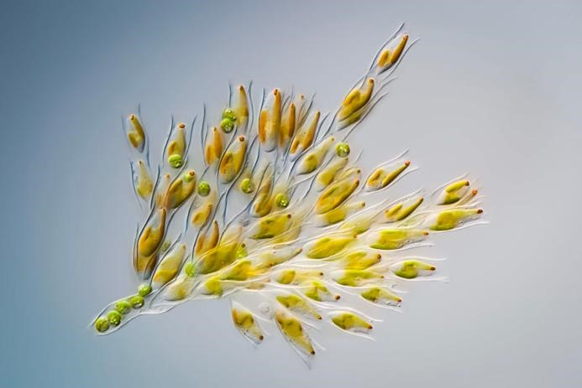
6.5 Golden Algae Synura
Notes:
They are characterized by the pigment fucoxanthin that give them their distinctive color. They are single-celled biflagellates with two specialized flagella.

Slide 7
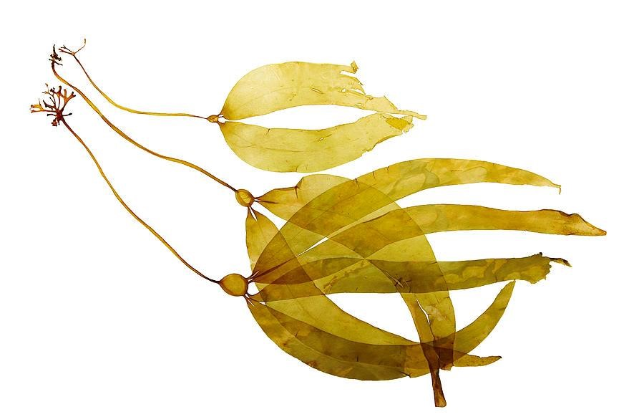
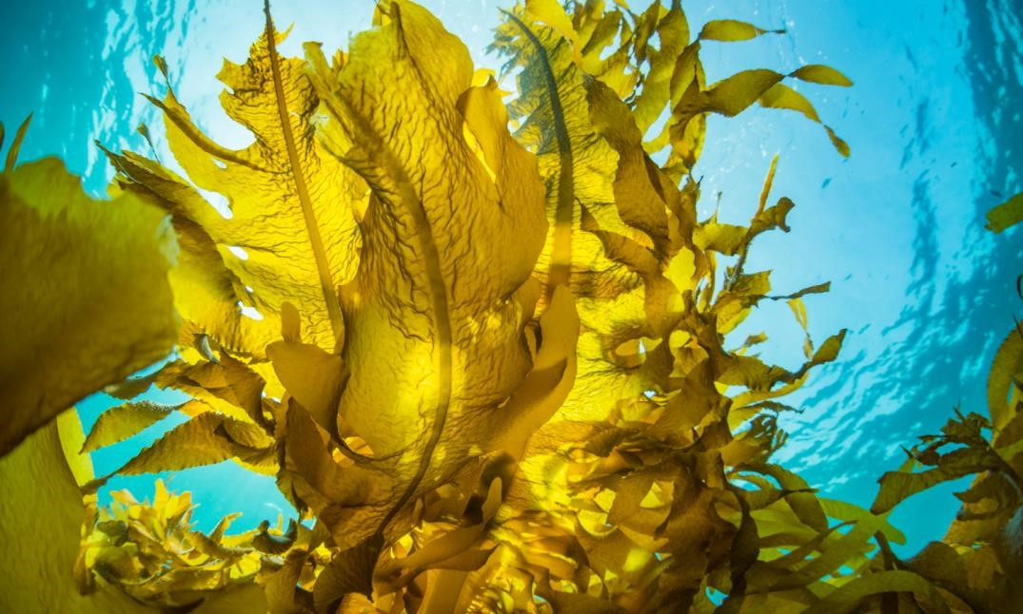
6.6 Brown Algae
Notes:
Brown algae are unique among heterokonts in developing into multicellular forms with differentiated tissues.

Slide 8
6.7 Sargassum
Sargasso sea is located in the Atlantic Ocean.
It is a vast patch of ocean named for the free-floating seaweed Sargassum.
The sea is a spawning site for threatened and endangered eels, as well as white marlin, porbeagle shark, and dolphinfish.

Slide 9
6.8 SAR Clade Alveolates
The longitudinal flagellum is present in the sulcal groove of thecal plates.
This flagellum moves the cell in a forward direction by whipping backward and forward.
The traversal flagellum is present in the cingulum groove that arises from the equator of the cell.
This flagellum enables the dinoflagellate to operate, turn, and move in a forward direction.
In this way, the coordination of these two flagella makes this organism to move spirally through the water.

Slide 10
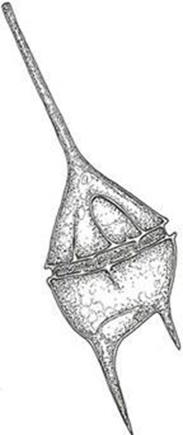
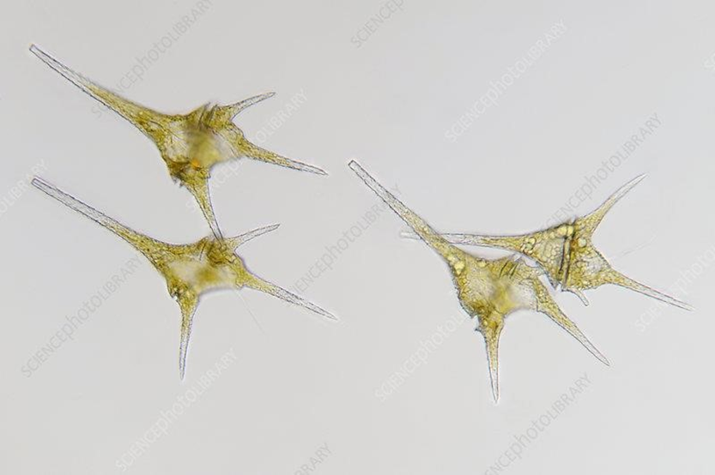
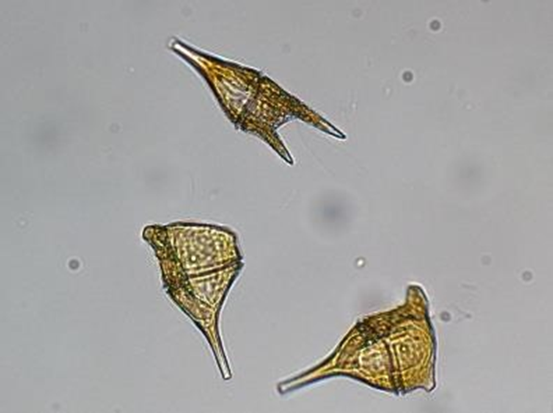
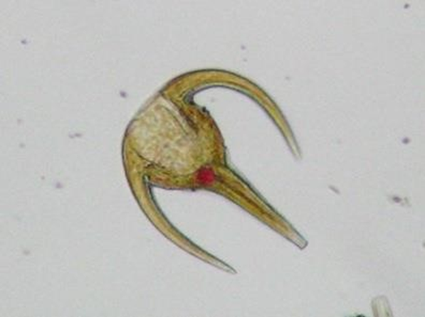
6.9 SAR Clade Alveolates
Dinoflagellate Ceratium
Mag: N/A
Notes:
The organisms have two unlike flagella.

Slide 11
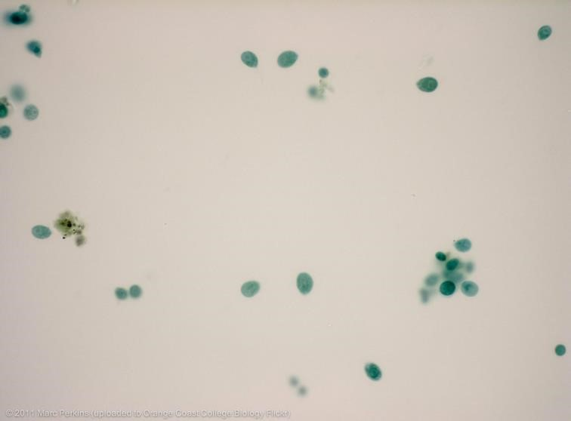
6.10 Malaria Infected Cells
Mag: N/A
Protist
RBC
Notes:
The cells with protists are big with distinctive appearance when stained.

Slide 12
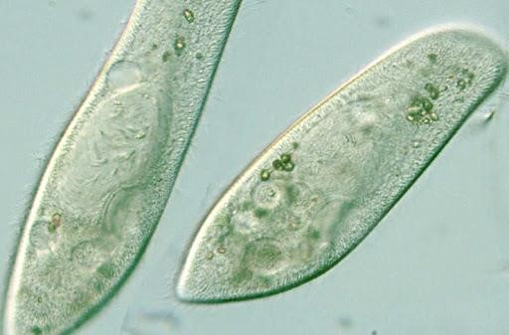
6.11 SAR Clade ALveolates_Ciliates
Paramecium
Mag: N/A
Macronucleus
Micronucleus
Oral groove
Notes:
paramecium is lengthy and resembles like the sole of slipper or shoes.

Slide 13
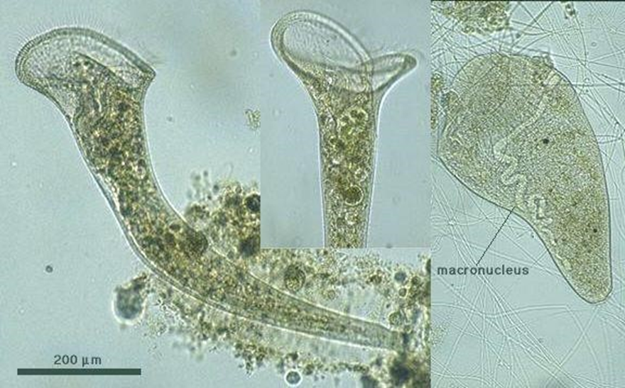
6.12 SAR Clade ALveolates_Ciliates
Stentor
Mag: x20
String of pearls nucleus
Cilia
Notes:
Stentor has multiple ciliary membranelles spiraling around the region that leads to the mouth opening.

Slide 14
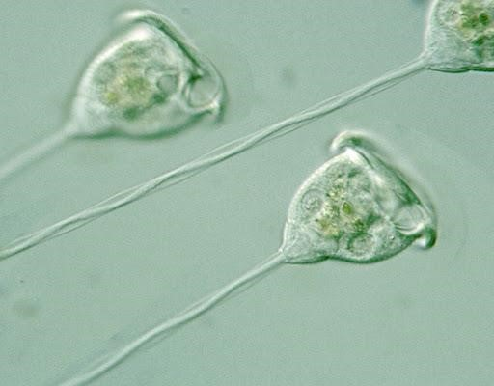
6.13 Vorticella
Mag: N/A
cilia
Thread-like stalk
Notes:
It is stalked ciliate with an inverted bell shape.

Slide 15
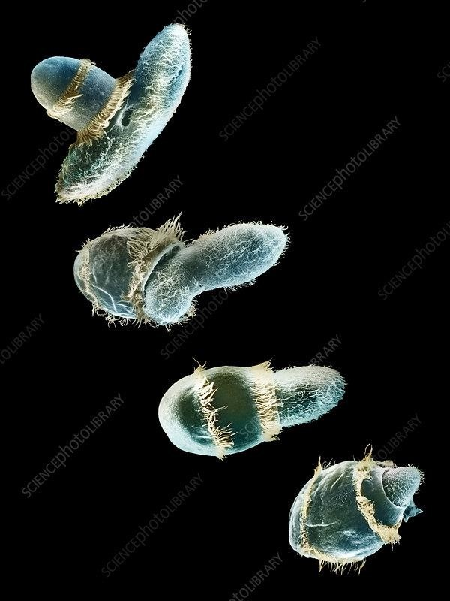
6.14 Didinium
Mag: N/A
Rings of cilia around the cell body
Notes:
Didinium are unicellular and have an oval shape. Didinium are heterotrophic organisms. Besides, the have a rings of cilia around their cell body.

Slide 16
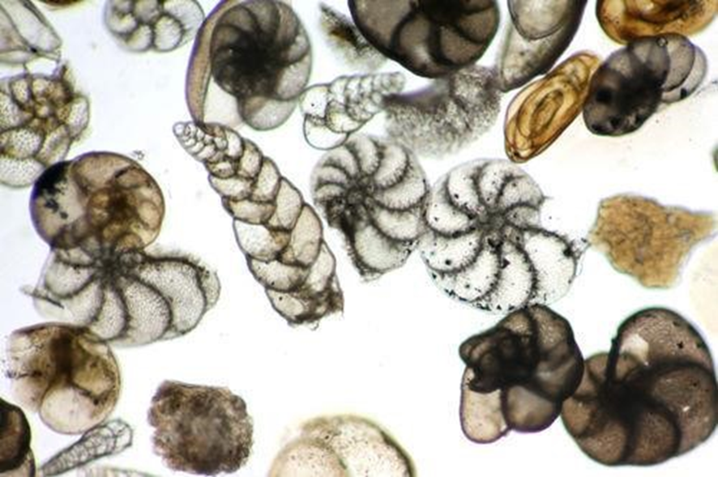
6.16 Foraminifera
Mag: N/A
pores
Notes:
A distinguishing structure in Foraminifera is the foramen, a hole that connects the wall (septa) between each chamber.

Slide 17
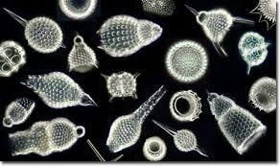
6.17 Radiolarians
Mag: N/A
pores
Notes:
Radiolarians have many needle-like pseudopods supported by bundles of microtubules, which aid in buoyancy.

Slide 18
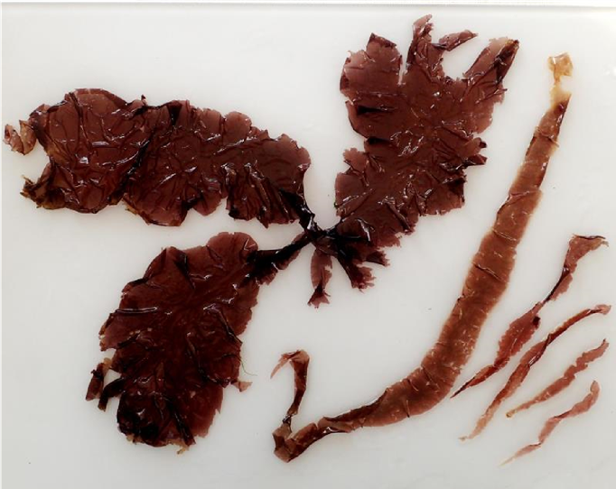
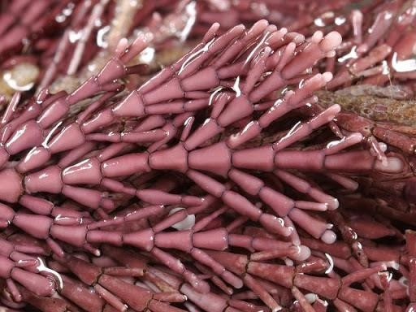
6.18 Supergroup Archaeplastida_Rhodophyta
Red Algae
Mag: N/A
Notes:
They have photosynthetic pigments phycoerythrin, phycocyanin, and allophycocyanins .

Slide 19
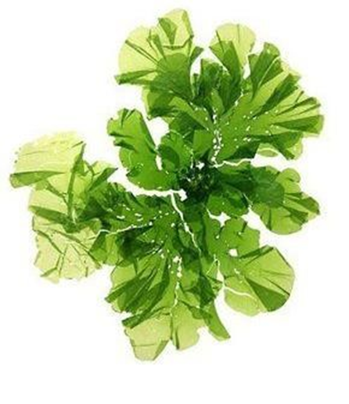
6.19 Supergroup Archaeplastida Green Algae
Ulva
Mag: N/A
Notes:
It is a thin flat green algae growing from a discoid holdfast.

Slide 20
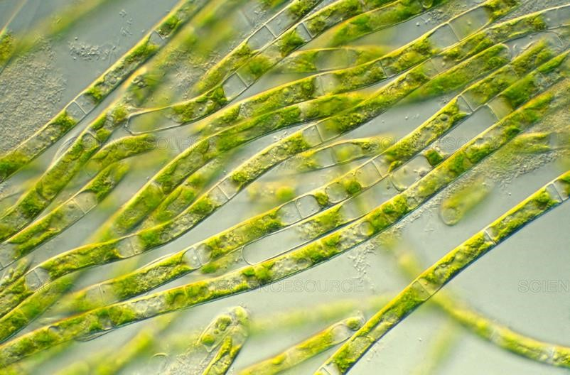
6.19 Supergroup Archaeplastida -Green Algae
Spirogyra
Mag: N/A
Notes:
They have a multi-cellular filamentous body.

Slide 21
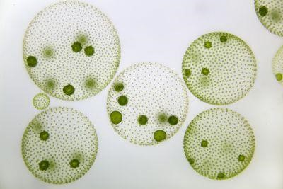
6.19 Supergroup Archaeplastida- Green Algae
Volvox
Mag: N/A
Notes:
A single colony of volvox looks like a ball of ~0.5 mm in diameter.

Slide 22
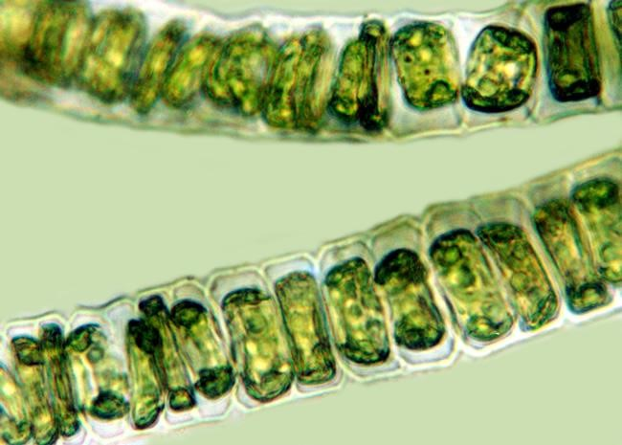
Chlorophyte Algae
Mag: N/A
Notes:
The algae is Green colour.

Slide 23
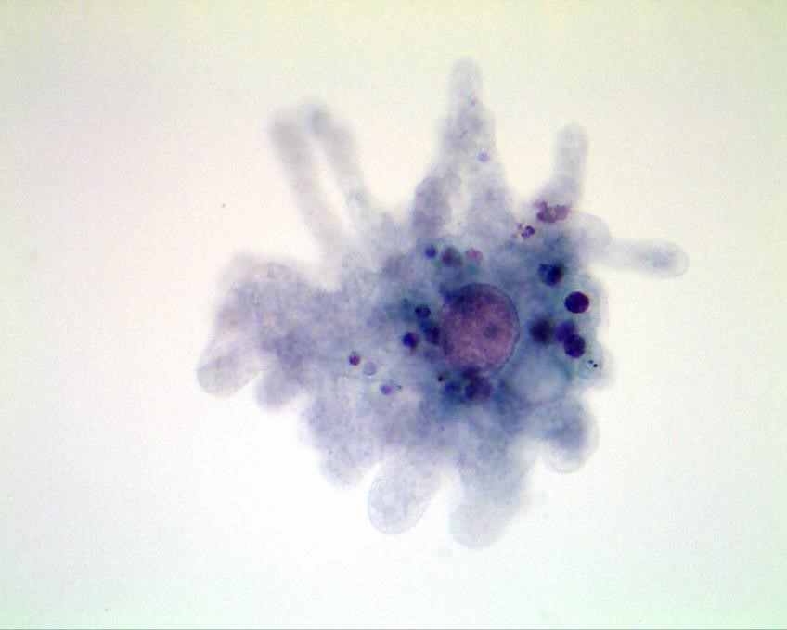
6.20 Supergroup Unikonta- Ameobozoa
Amoeba proteus
Mag: N/A
Notes:
The members of the genus Proteus are Gram negative.

Slide 24
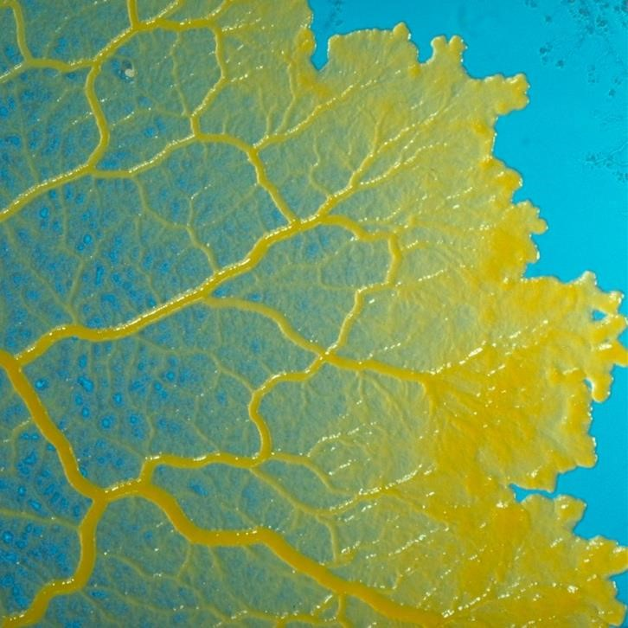
6.21 Physarum
Mag: N/A
Notes:
It often looks like a slimy substance, for example, the slime molds.

